Slide 1

Introduction
Jiaxuan You
Assistant Professor at UIUC CDS
CS598: Topics in LLM Agents, 2025 Spring
https://github.com/ulab-uiuc/CS598-Topics-in-LLM-Agents

Slide 2

Welcome to LLM Agents
An exciting new field
Change fast, less formal
Seminar
Discussion and presentation heavy
Grading
In class + Project (survey)
Goal
Equip you with excitement, knowledge, and insight
🌟Question: Why taking this course?
Draw an inspiring overview figure for a course that I'm teaching: Topics in LLM Agents

Slide 3
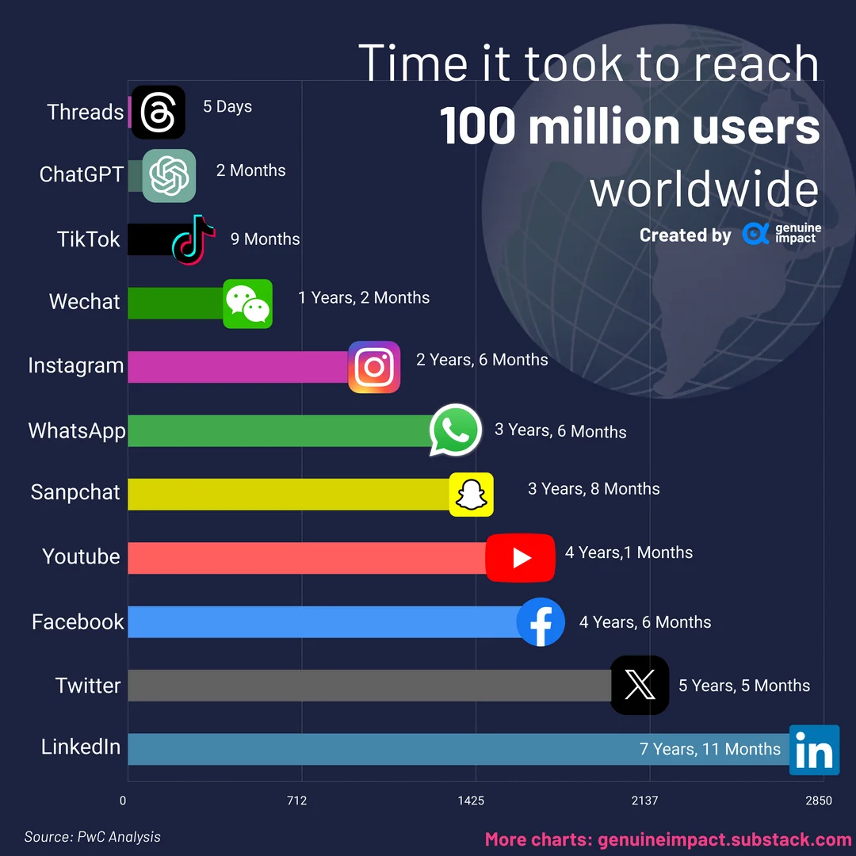
The “ChatGPT Moment”
LLMs have revolutionized the world
QA, Writing, Education, Companion, …
🌟Discussion: What is the most impressive application of LLMs that you have seen?

Slide 4

From LLMs to LLM Agents
Input
Output
Tokens
LLM
Tokens
LLMs
(Text & other modalities)
(Text & other modalities)
Perception
LLM
LLM Agents
Tokens
Actions

Slide 5
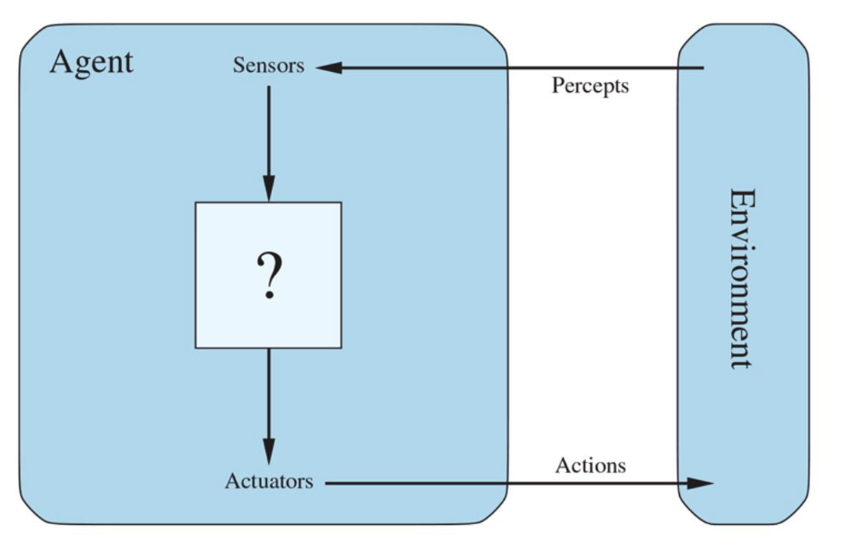
Why AI Agents?
Building agents is (arguably) the ultimate goal of AI research
"An agent is anything that can be viewed as perceiving its environment through sensors and acting upon that environment through actuators."
-- Russell & Norvig, Al: A Modern Approach (2020)
https://language-agent-tutorial.github.io/

Slide 6
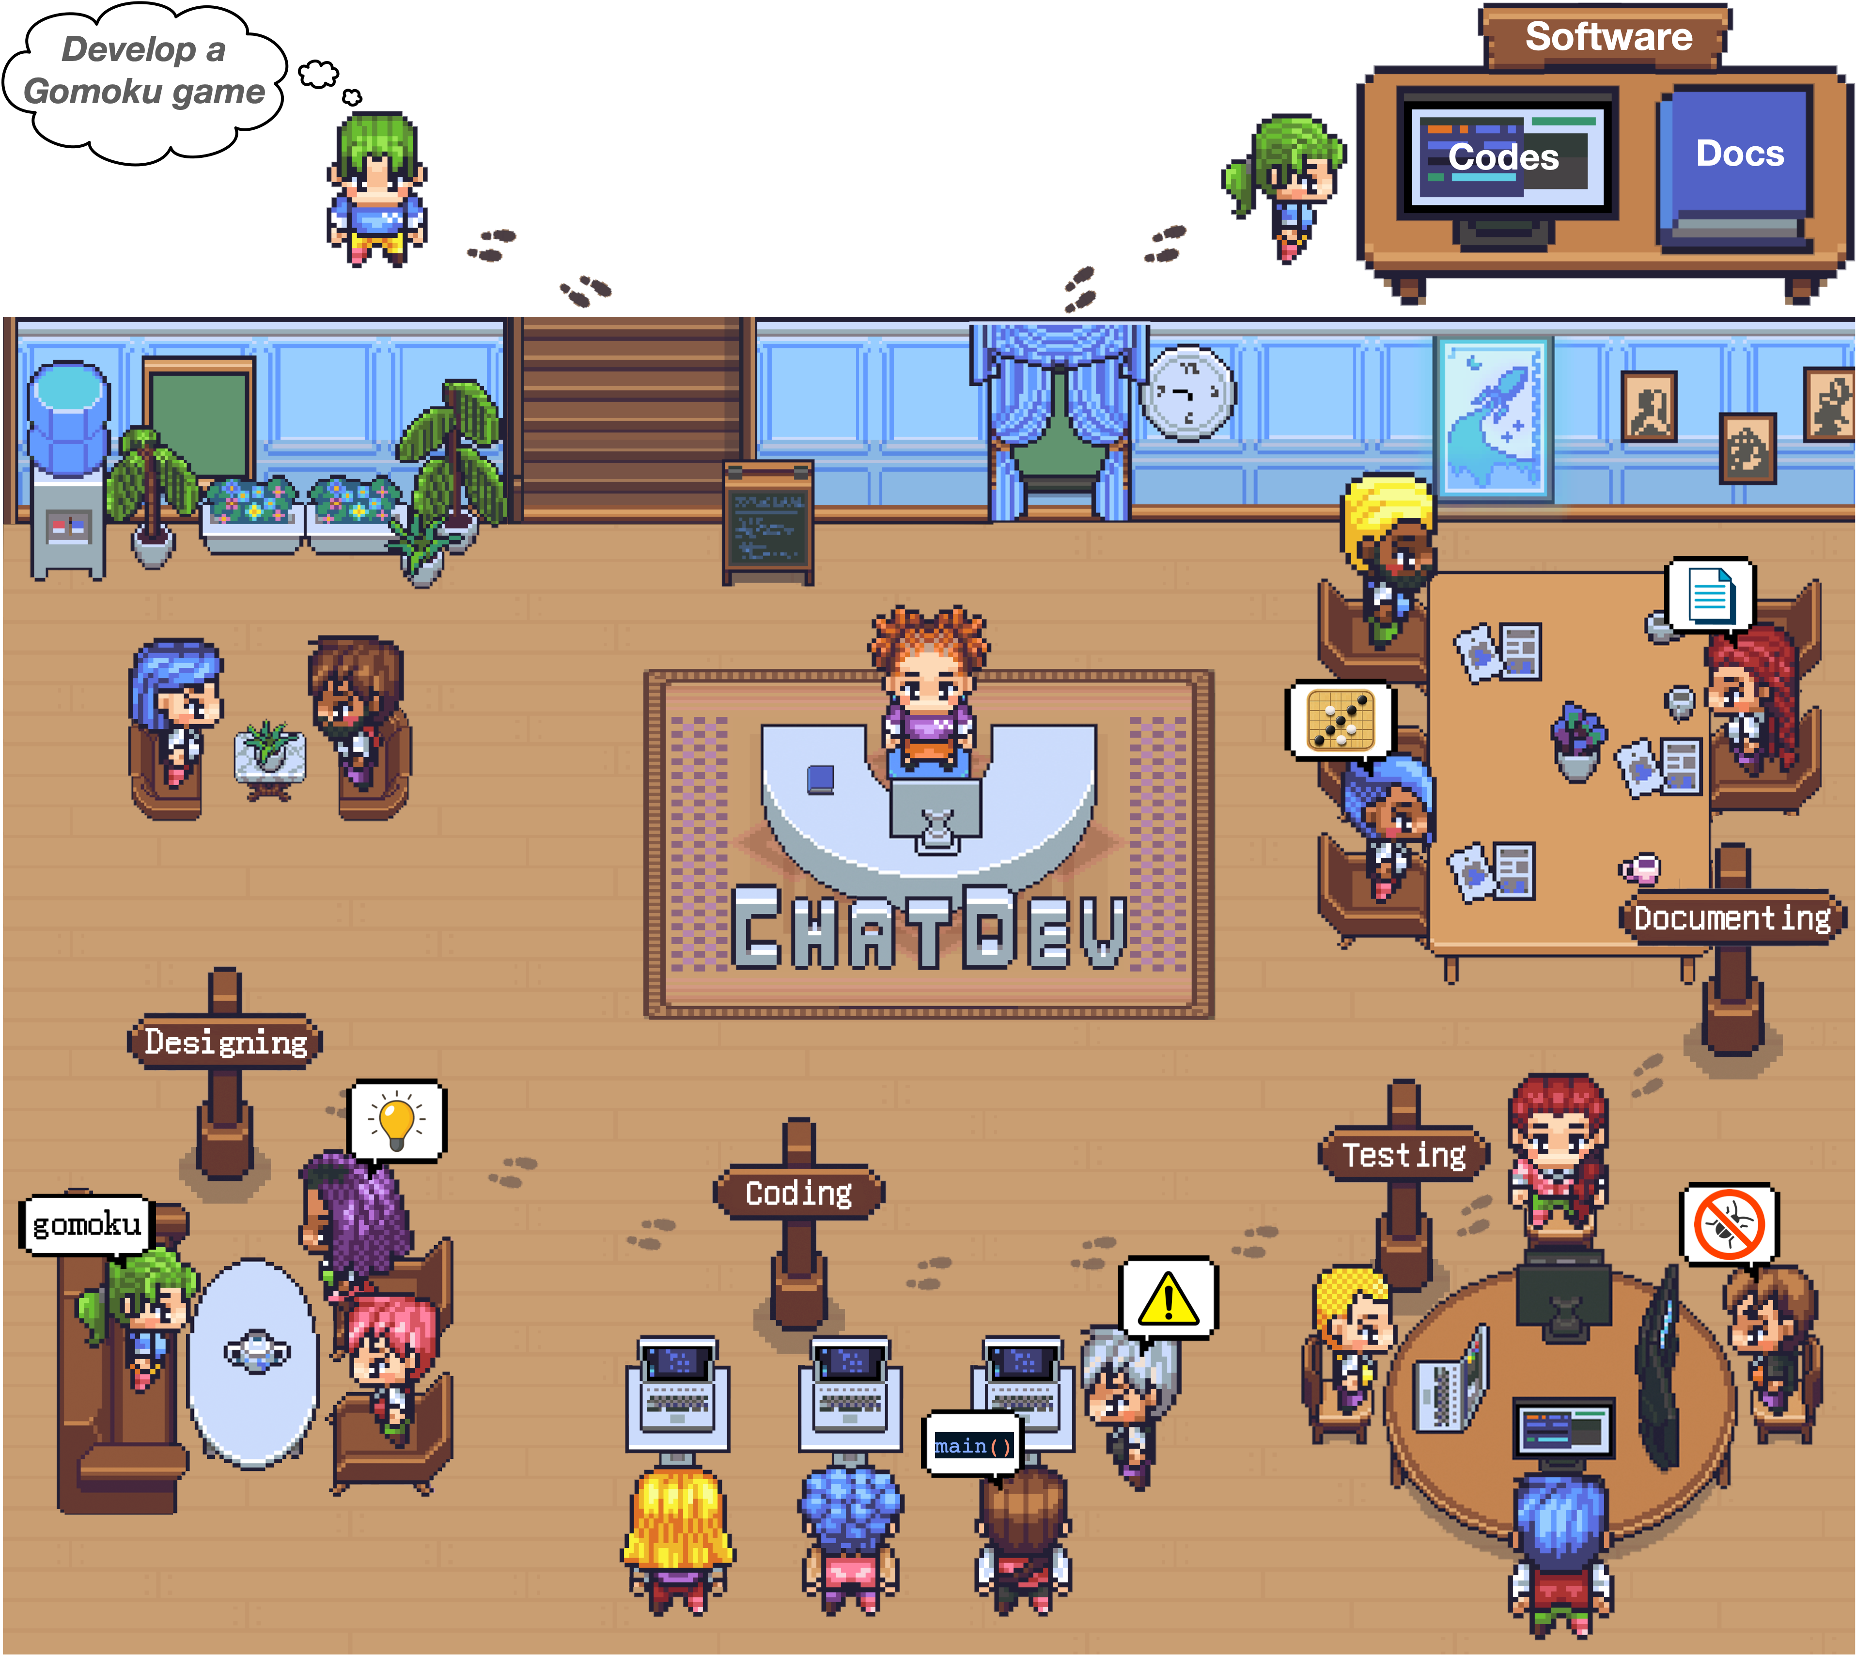

Why AI Agents?
AI agent can make real-world impact
Automated research
Software development

Slide 7
Why Building Agents with LLMs?
Languages, or tokens, are ideal for building AI agents
Perception: the world can be described by language
Intelligence: planning, reasoning, reflection, can all be described by language
Action: agent can use language to interact with the world: coding, use of APIs/tools
Data availability: Human perception and intelligence have been described with language, leading to 100T+ tokens
🌟Discussion: Do you believe language is essential for AI agents? Pros/Cons? Can AI agents develop their own languages?

Slide 8

Course Logistics
Introduction

Slide 9


Teaching Staff
Instructor: Jiaxuan You
Assistant Prof joined in 2024 Fall
LLM agents, graphs, science, …
Teaching Assistant: Jinwei Yao
1st Year MSCS
Interested in LLM Systems

Slide 10
Course Logistics
Meeting Times:
Tuesday/Thursday, 03:30 PM - 04:45 PM
Urbana-Champaign Campus | Siebel Center Room 1304
Slides of the lectures will be posted on Github
Structure of lectures:
Beginning: Overview of LLM Agents (by Jiaxuan);
Afterward: Seminars led by students for discussion
Pilot-Presenter Group: Present the content of a paper
Copilot-Reviewers Group: Panel discussion with Pilots, write paper summary
Audience (Rest of the class): participate in discussions
Office hours: 1 hour (Instructor) + 1 hours (TA). Details to be announced.

Slide 11
Course Console
Github
https://github.com/ulab-uiuc/CS598-Topics-in-LLM-Agents
Main website with course information
Canvas
Announcement, homework/report submission
Piazza
https://piazza.com/illinois/spring2025/cs598jy2
For Q&A, online team building.
OpenReview (Or Github)
Review and response for your survey project
Details to be announced.

Slide 12
Course Objective
Takeaways from this course:
Overview of Latest LLM Agent Papers
Build a roadmap of LLM agents
Critique and evaluate the design details
Training for AI research
Experience the full lifecycle as an AI researcher
Read, Ideate, Discuss, Write, Review, Present

Slide 13

Schedule
Topics(# of Lectures)
Agent Overview(3)
Agent Evaluation(1)
Agent Applications(4)
Red: by Jiaxuan
Blue: by students
AI Agent
AGI
Agent Ability(4)
Agent Frameworks(3)
Agent Challenges To AGI(4)
https://github.com/ulab-uiuc/CS598-Topics-in-LLM-Agents
A Research Seminar Course:
Platform for active research discussions – each lecture is like a workshop

Slide 14
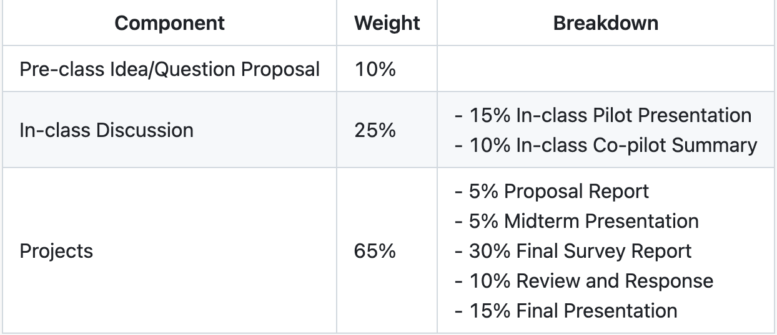
Grading (Details to be finalized)
ALL activities will be done in groups except for your Pre-class activity!

Slide 15
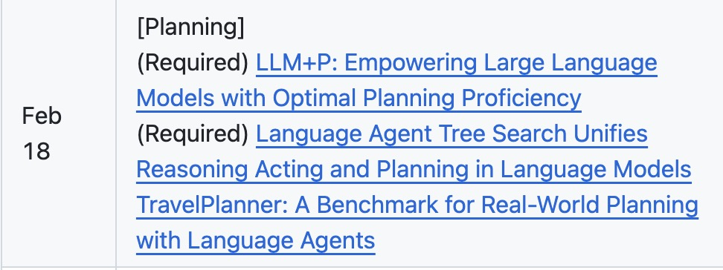
Pre-class activity
Pre-class Question/Idea proposal
Takes 10% of the final grade
After reading of "required" papers in the schedule
Up to five absences
Fill the google form to propose an insightful question/idea
https://docs.google.com/forms/d/e/1FAIpQLSdZV1u6A7WCVBihXsJI5E2AXxwi9IRFgiBJIjNVZaJ1OeBX5g/viewform?usp=header
Due: before each lecture(start from the second lecture)
ALL activities will be done in groups except for your Pre-class activity!

Slide 16
Form a team ASAP
Form a team ASAP
Use Piazza to find potential group members
Group size should be 3
May allow a few smaller groups if/when students drop out
Submit at Google Form
By Jan 30 the latest, but right now is better
https://docs.google.com/forms/d/e/1FAIpQLSdDTtBOoZyMoQtq8EN0Zef_viHxujb4M3ImwkTtbZC48hOU3w/viewform?usp=header
ALL activities will be done in groups except for your Pre-class activity!

Slide 17
In-class activity
In-class presentation/discussion
Takes 25% of the final grade
15% - 1 presentation as "pilot presenters"
10% - 1 paper summary as " co-pilot reviewers"
Each group would be assigned each role once
Pilot Presenter
Co-pilot Reviewers
Rest of class-audience
ALL activities will be done in groups except for your Pre-class activity!

Slide 18
In-class activity- Paper presentation
Presenter Group : Lead the discussion (details)
Aim for 30-40 min presentation w/o interruption, but there will be intermittent discussions
Go through the required papers in details, along with its strengths and weaknesses
ALL activities will be done in groups except for your Pre-class activity!

Slide 19
In-class activity- Panel discussion
"Reviewers" Group
Host a panel after the presentation together with Pilots
Reviewers challenge the presented paper, shared constructive feedback
Pilots and audience will debate with reviewers
Reviewers share summary of all the discussions within 2 days after class presentation
ALL activities will be done in groups except for your Pre-class activity!

Slide 20
Paper Summaries
1 summaries per-group, covering required and companion papers
Each summary must follow the template and address the following
What is the problem and why is it important?
What is the hypothesis of the work?
What is the proposed solution, and what key insight guides their solution?
What is one (or more) drawback/limitation, and how will you improve it?
Summary should include the gist of class discussion
Template here
ALL activities will be done in groups except for your Pre-class activity!

Slide 21
Summary of Your Role
Presenter Group
Reviewer Group
1.Share slides 24 hrs before class
2.Maximum 40-minute presentation
3.Respond to questions on Piazza
4.Share your final slides after class
Challenge the research paper
Host panel discussions
3. Share summary within 2 days after
class presentation
Everyone(Audience)
1.Read required papers
2.Submit one insightful question/idea per
required reading before each lecture

Slide 22
Project- A Research Survey
The final project accounts for 65% of total grades!
A survey within the range of LLM agents
Not too ambitious--"Survey of AI Agents" is not good
Not too narrow--"Survey of Minecraft gaming agents" is not good
Could be the same with your presentation topic like "gaming agents"
But not mandatory
ALL activities will be done in groups except for your Pre-class activity!

Slide 23
Project- A Research Survey
We will simulate the lifecycle of research
Draft Proposal
Adjustment (Midterm checkpoint)
Paper Submission
Review&Response
Final Revision (Camera ready)
ALL activities will be done in groups except for your Pre-class activity!

Slide 24
Project- A Research Survey
Draft Proposal (DDL Feb 10)
Two pages in template adapted from TMLR, plus as many pages as needed for references
Should include (To be finalized)
Problem: What is the problem?
Motivation: Why is it important?
Scope: Why it cannot be narrower or larger? What will be included/excluded?
Related work: What has been done so far? How to summarize the progress?
Future directions: What can be done in the future to address the problem?
Plan: Your timeline & work distribution
Submit as a group, including your group information (form a group ASAP)
ALL activities will be done in groups except for your Pre-class activity!

Slide 25
Project- A Research Survey
Midterm Checkpoint (March 11/13)
In-class short presentation&discussion over two days
This is to make sure you are receiving feedback and making progress
Tentative format
Each group present their progress
Raise common questions for discussions
ALL activities will be done in groups except for your Pre-class activity!

Slide 26
Project- A Research Survey
Draft submission (by April 16 23:59)
At least 9 pages & 30 references (tentative, exclude reference) in template adapted from TMLR
Submit to OpenReview for Review&Response
And Canvas for archive
No need to be perfect but should be complete->submit it anyway.
Delay punishment: 1 points deduction of your project per day
Because it causes trouble in review&response
Max 10 point deduction
ALL activities will be done in groups except for your Pre-class activity!

Slide 27
Project- A Research Survey
Review(April 17-April 23 23:59)
1 point of the review score will be deducted for each day of delay
Max 5 points
Penalty exemption if the previous draft is not submitted on time
Each group needs to write reviews for 3 other groups(assigned)
1 person-> 1 review
Response(April 24-April 30 23:59)
1 point of the response score will be deducted for each day of delay
Max 5 points
Penalty exemption if the previous review is not submitted on time
Response to your reviews
ALL activities will be done in groups except for your Pre-class activity!

Slide 28
Project- A Research Survey
Final Presentation (May 1/6)
Time limit (To be announced)
Final report submission(May 8 23:59)
a.k.a, "Camera ready" in template adapted from TMLR
At least 10 pages, 30 references, no page limit (exclude reference)
Submit to Canvas (for grading)
2 point will be deducted for each day of delay
ALL activities will be done in groups except for your Pre-class activity!

Slide 29
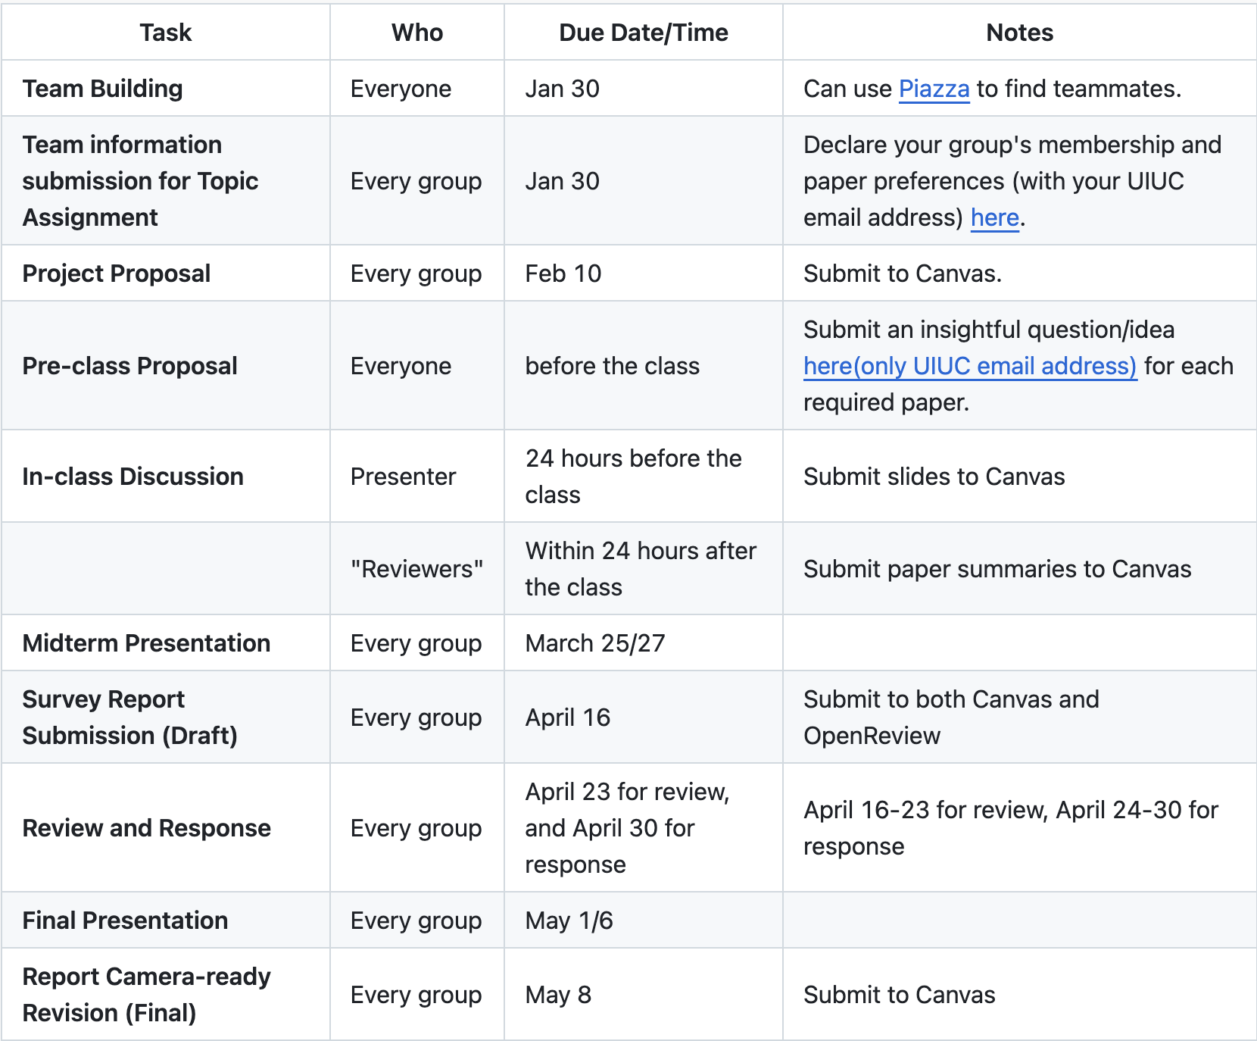
Summary of Due(Tentative)
Any questions?
Again:
Form Groups of 3;
submit by Jan 30

